Slide 1
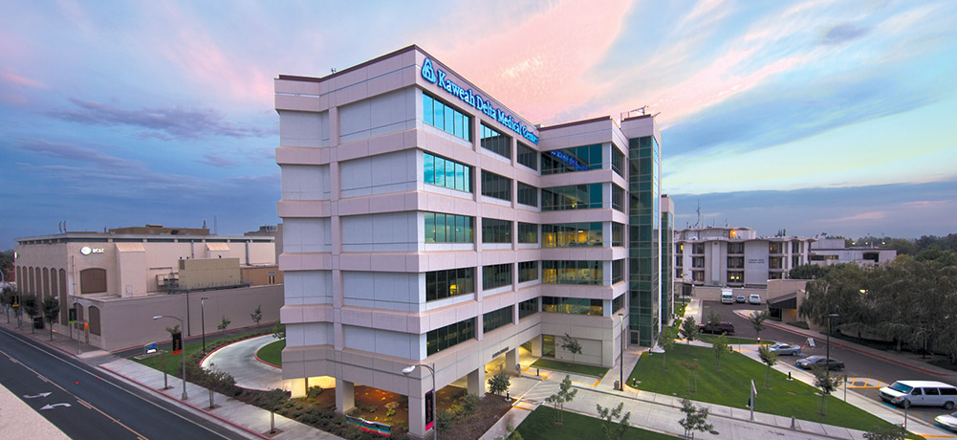


Medical Staff
H&P Documentation:
Required Elements
April 2026

Slide 2

All entries shall be dated, timed, have a legible physician signature, and contain the following required elements:
History and Physical Elements for Acute Care Hospital Inpatients
Chief complaint History of present illness Pertinent Current and past medical problems Surgical history Medications with dosage and timing Allergies and reactions Social history Vitals (For Pediatric Patients including weight & height) Heart exam Lung exam Examination of pertinent body parts |  | Applicable laboratory and radiologic data that leads to the main diagnosis or any secondary diagnoses Main diagnosis Secondary diagnoses Treatment plans for main and secondary diagnoses (“see orders” is not appropriate) Mental Health Patients require mental status exam On the chart in a typed form within 24 hours of admission, handwriting is for computer downtime or emergencies only

Slide 3
All entries shall be dated, timed, have a legible physician signature, and contain the following required elements:
History and Physical Elements for Outpatient Surgery or Procedures at the Acute Care Hospital
History of present illness Pertinent Current and past medical problems Surgical history Medications Allergies and reactions Heart exam |  | Lung exam Examination of pertinent body parts Main diagnosis Treatment plans for main diagnosis (“see orders” is not appropriate) On the chart in a typed form within 24 hours of admission, handwriting is for computer downtime or emergencies only

Slide 4
All entries shall be dated, timed, have a legible physician signature, and contain the following required elements:
History and Physical Elements for Newborns
History of present illness, including pertinent history of the mother’s labor and delivery Maternal risk factors during pregnancy or delivery if applicable Maternal prenatal testing Hospital Course so far Hearing screen- completed or planned CCHD Screenings -completed or planned Immunizations- completed or planned |  | Transcutaneous bilirubin- completed or planned Physical exam including length and weight Applicable laboratory and radiologic Main diagnosis Secondary diagnoses Treatment plans for main and secondary diagnoses (“see orders” is not appropriate) On the chart in a typed form within 24 hours of birth, handwriting is for computer downtime or emergencies only

Slide 5
All entries shall be dated, timed, have a legible physician signature, and contain the following required elements:
Operative Note/Procedure Note/Endoscopy Note/Catheterization Lab Note-
Pre-operative diagnosis Post-operative diagnosis Procedure Date of Procedure Surgeon Assistant(s) (RNFA or Resident are acceptable) Anesthesia type Anesthesia provider (Anesthesia team is acceptable) Findings |  | Blood Loss Specimens Implants if used Narrative of the details of the procedure Complications if any Post-op Condition On the chart in a typed form within 24 hours of the procedure, handwriting is for computer downtime or emergencies only
Name(s) of the surgeon(s) and assistants or other practitioners who performed surgical tasks (even when performing those tasks under supervision) and a description of the specific significant surgical tasks that were conducted by practitioners other than the primary surgeon/practitioner (significant surgical procedures include opening and closing, harvesting grafts, dissecting tissue, removing tissue, implanting devices, altering tissues)

Slide 6
All entries shall be dated, timed, have a legible physician signature, and contain the following required elements:
Brief Operative Note Elements
Post-operative diagnosis Procedure Date of Procedure Surgeon Anesthesia type |  | Findings Blood Loss Specimens Post op Condition Typed before the patient changes level of care

